Slide 1
TREND 1:
SIMPLICITY
TREND 2:
INTERACTIVITY
TREND 3:
PERSONALIZATION
HOW THIS APPLIES
TO COLLECTIVE
01
02
03
04

Slide 2

1
SIMPLICITY

Slide 3
WHAT ARE THE CURRENT TRENDS?

Slide 4





LESS DEVICES
AND MORE FUNCTIONS ON EACH DEVICE

Slide 5

Trends
FOR EXAMPLE….
Less devices
More functions on each device
COIN COMBINES ALL YOUR CREDIT CARDS INTO ONE
simplifying the payment system for the consumer

Slide 6
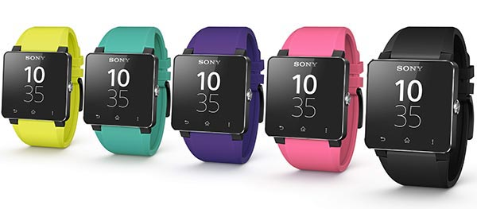
SMARTWATCHES AND WEARABLE TECH ARE Taking the role of tracking and acting as a complements to smartphones

Slide 7
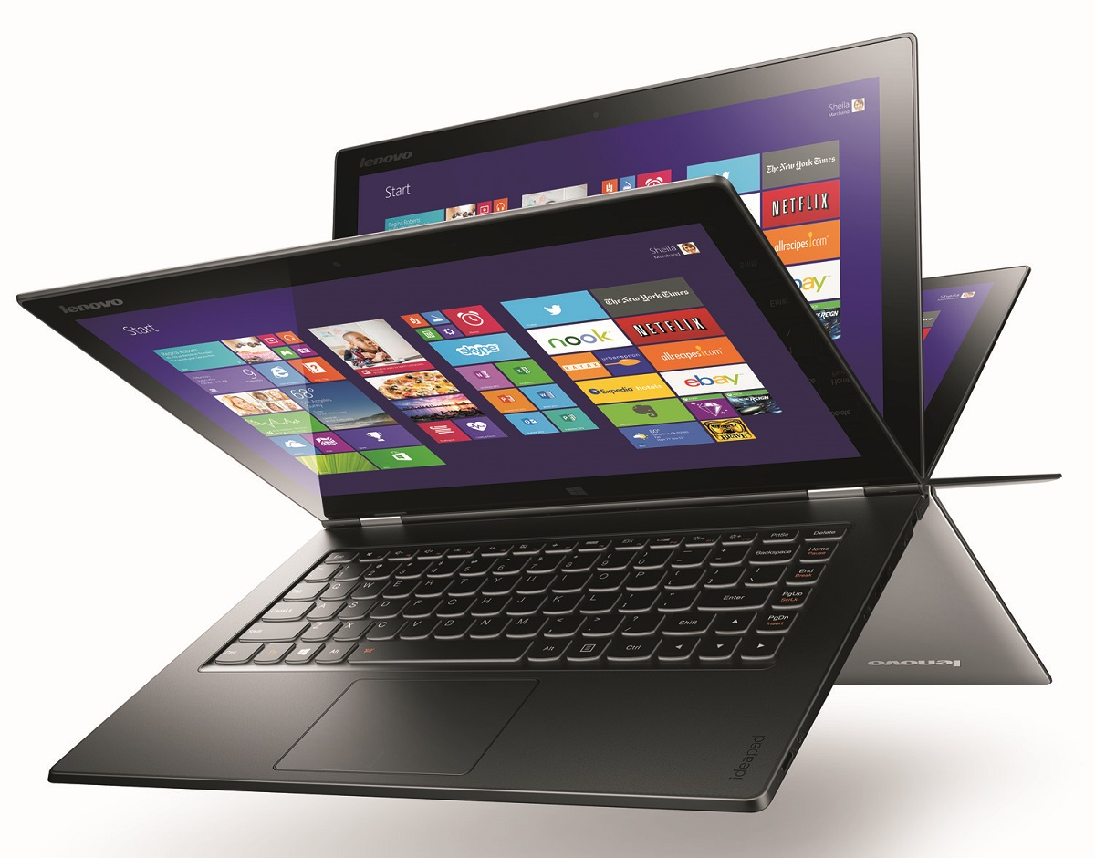
LESS DEVICES: TWO IN ONE LAPTOPS WILL REPLACE THE NEED FOR TABLETS

Slide 8
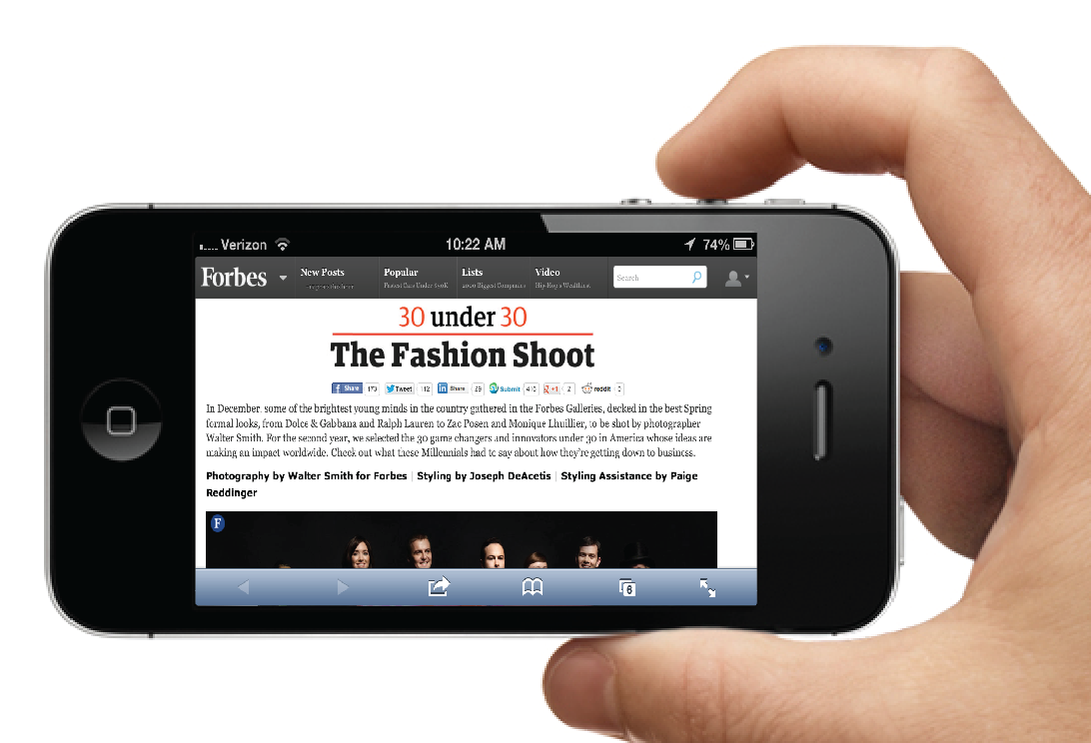
MORE FUNCTIONS ON EACH DEVICE
APPLE IS PLANNING TO COME OUT WITH A SYSTEM THAT ALLOWS CONSUMERS TO USE THE PHONE AS PAYMENT
iv

Slide 9
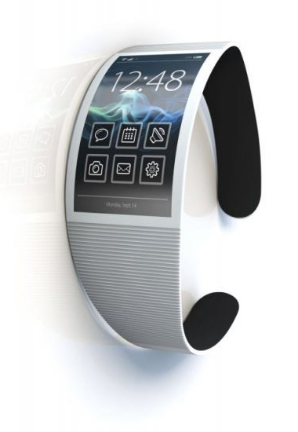
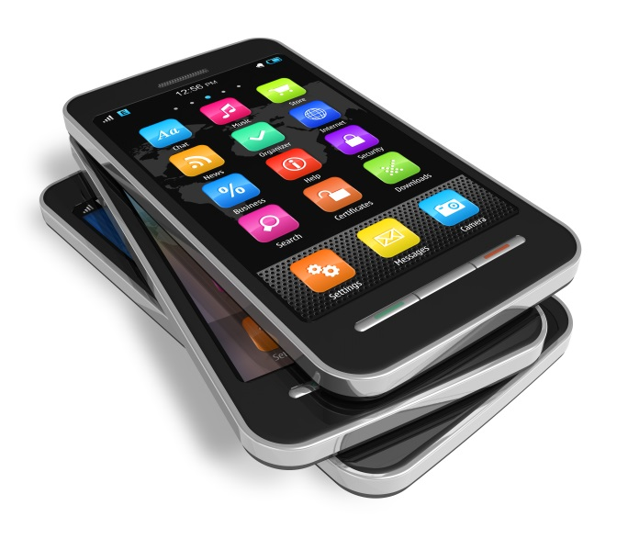
“Two device threshold
WEARABLE WILL ACT PRIMARILY AS TRACKER
PHONE WILL ACT AS DISPLAY

Slide 10
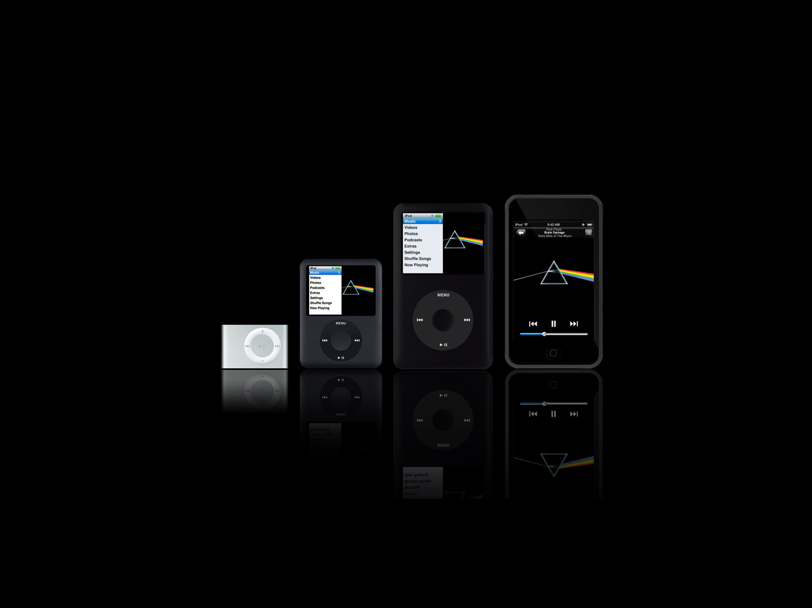
ARE THESE TRENDS ACTUALLY TRUE?
LET’S TAKE A LOOK AT APPLE….
FROM THE IPOD TO THE IPHONE TO SOMETHING MUCH MORE

Slide 11
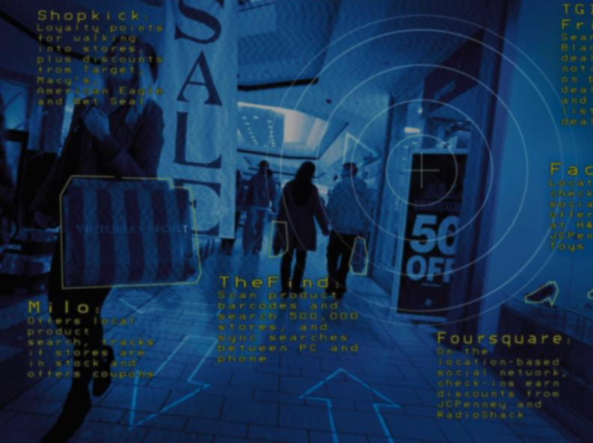
WHAT DOES THIS MEAN FOR THE CONSUMER?
MUCH MORE CONSOLIDATED PAYMENT OPTIONS
MORE CURATED EXPERIENCES/PRODUCT SELECTION
PAYMENT INNOVATION

Slide 12
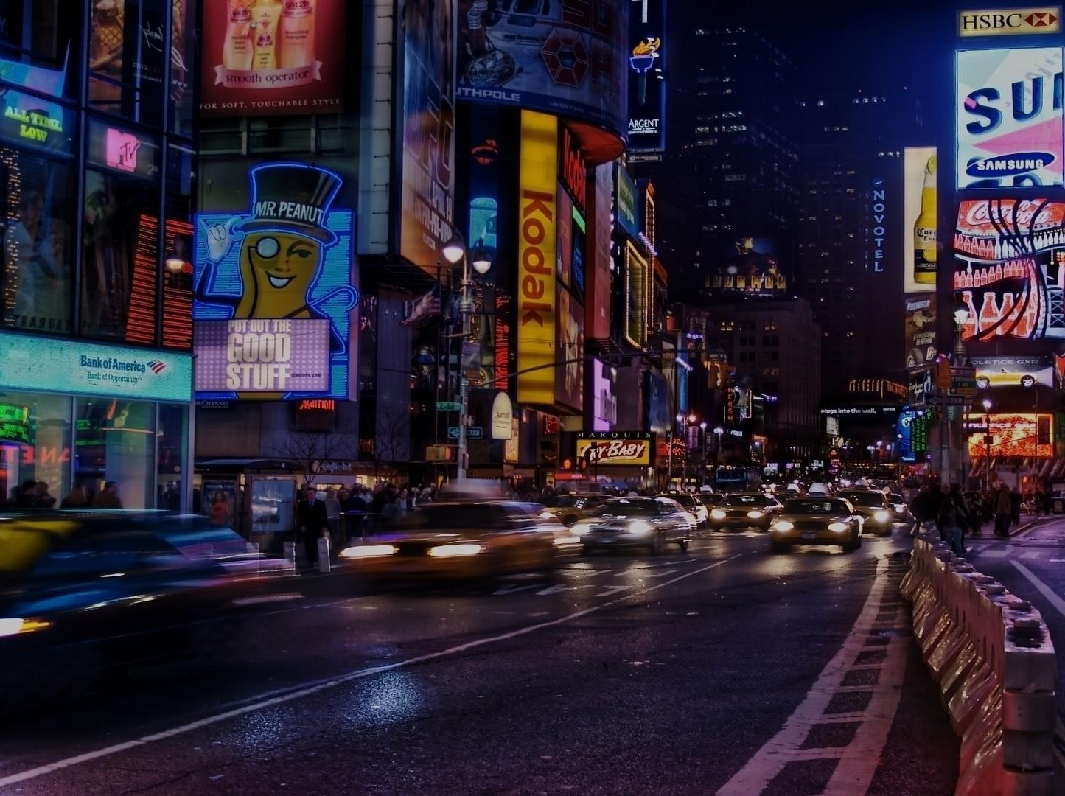
2
INTERACTIVITY

Slide 13
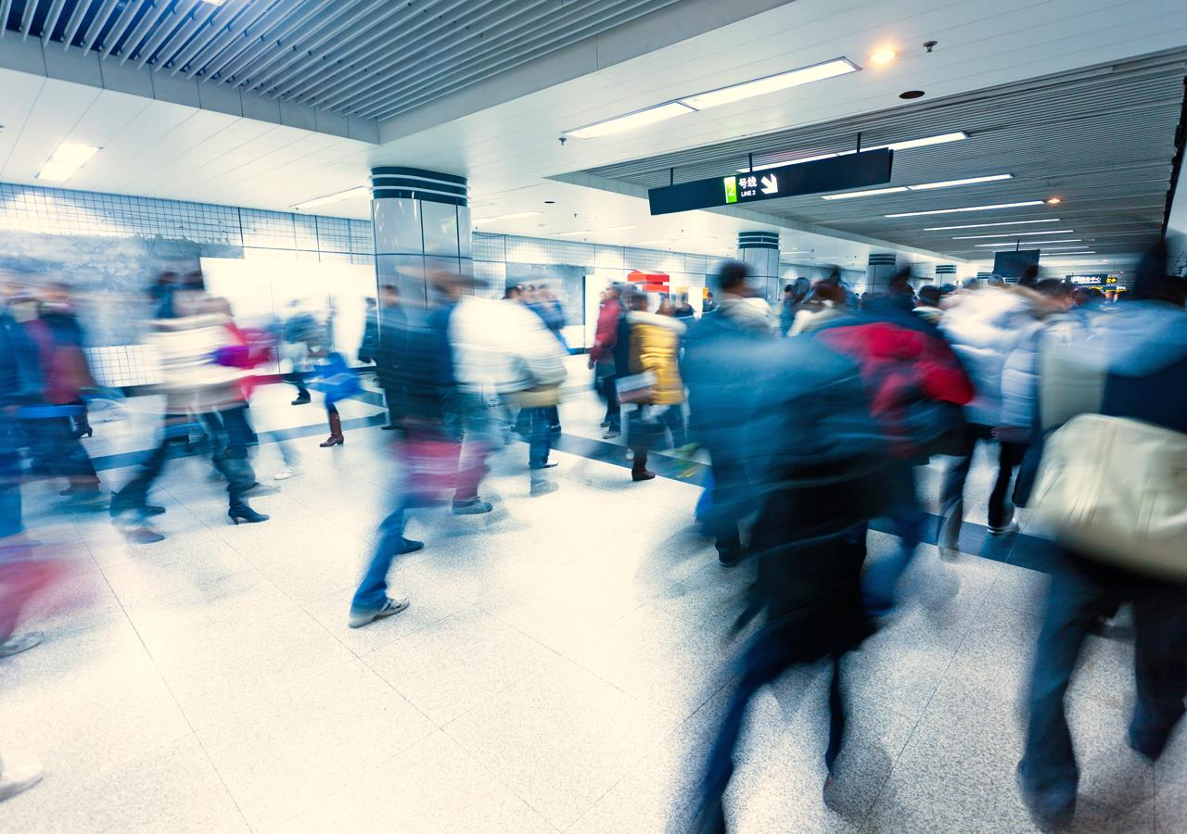
THERE ARE THREE TYPES OF INTERACTIONS
BUSINESS TO CONSUMER
CONSUMER TO CONSUMER
SYSTEM
TO
SYSTEM

Slide 14
CONSUMER TO CONSUMER
CONSUMERS INTERACT WITH EACH OTHER PRIMARILY THROUGH SOCIAL MEDIA

Slide 15

CONSUMER TO CONSUMER
Over 50% of Facebook users
have more than 20o friends
71% have facebook accounts

Slide 16
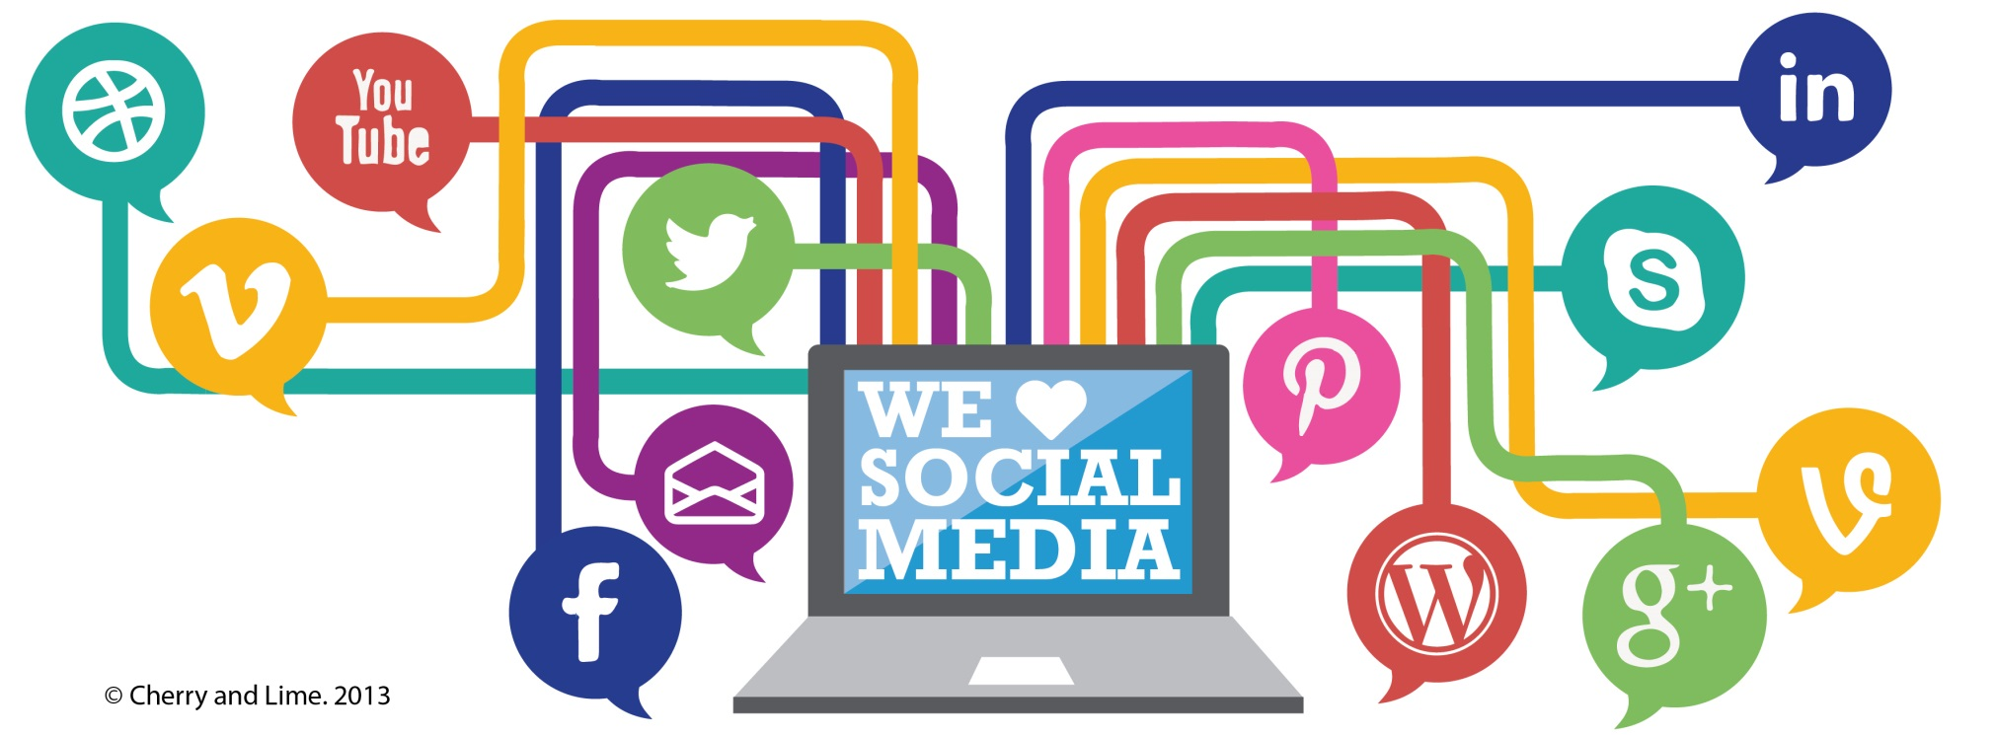
CONSUMER TO CONSUMER
IN TERMS OF RETAIL, THE USER EXPERIENCE DOESN’T END WITH JUST THE PURchase.
Users will interact amongst each other through means of social media such as yelp, facebook, twitter, etc.

Slide 17

BUSINESS TO CONSUMER
HOWEVER, SOCIAL MEDIA ALSO INCLUDES BUSINESS TO CONSUMER INTERACTIONS
58% of facebook users like brands
80% PREFER PROMOTIONS FROM BRANDS ON FB

Slide 18

BUSINESS TO CONSUMER
HOW BUSINESSES REACH THEIR CONSUMERS HAS CHANGED EXPONENTIALLY

Slide 19
BUSINESS TO CONSUMER
TRADITIONAL MARKETING
selling
product attributes
engage and reward
interactions
INTERACTIVE MARKETING

Slide 20
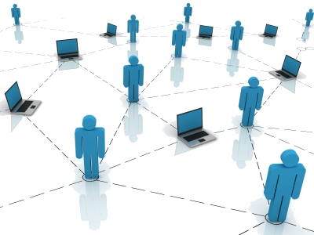
SYSTEM
TO
SYSTEM
AND LASTLY, THE MULTIPLE SYSTEMS WE USE EVERY DAY INTERACT IN MORE WAYS you CAN IMAGINE…

Slide 21
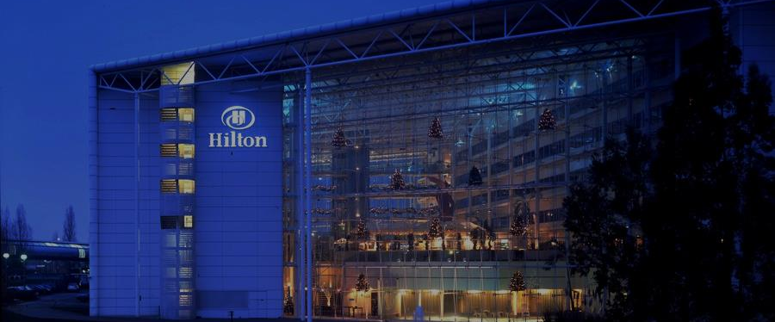



SYSTEM
TO
SYSTEM
Using mobile phone for check in’s, orders, keys
USING APP FOR RESERVATIONS, maps, information

Slide 22

HOW DOES THIS APPLY TO THE FUTURE?

Slide 23
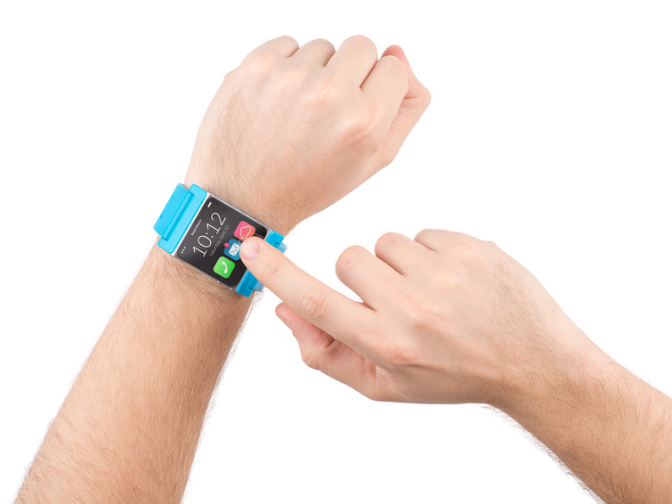
MEDIA WILL BE STREAMLINED and minimized DEPENDING ON PERSON’S INTERACTIONS

Slide 24
RETAIL WILL CONSIST OF A HANDS FREE SYSTEM BECAUSE OF SYSTEM INTERACTIONS

Slide 25
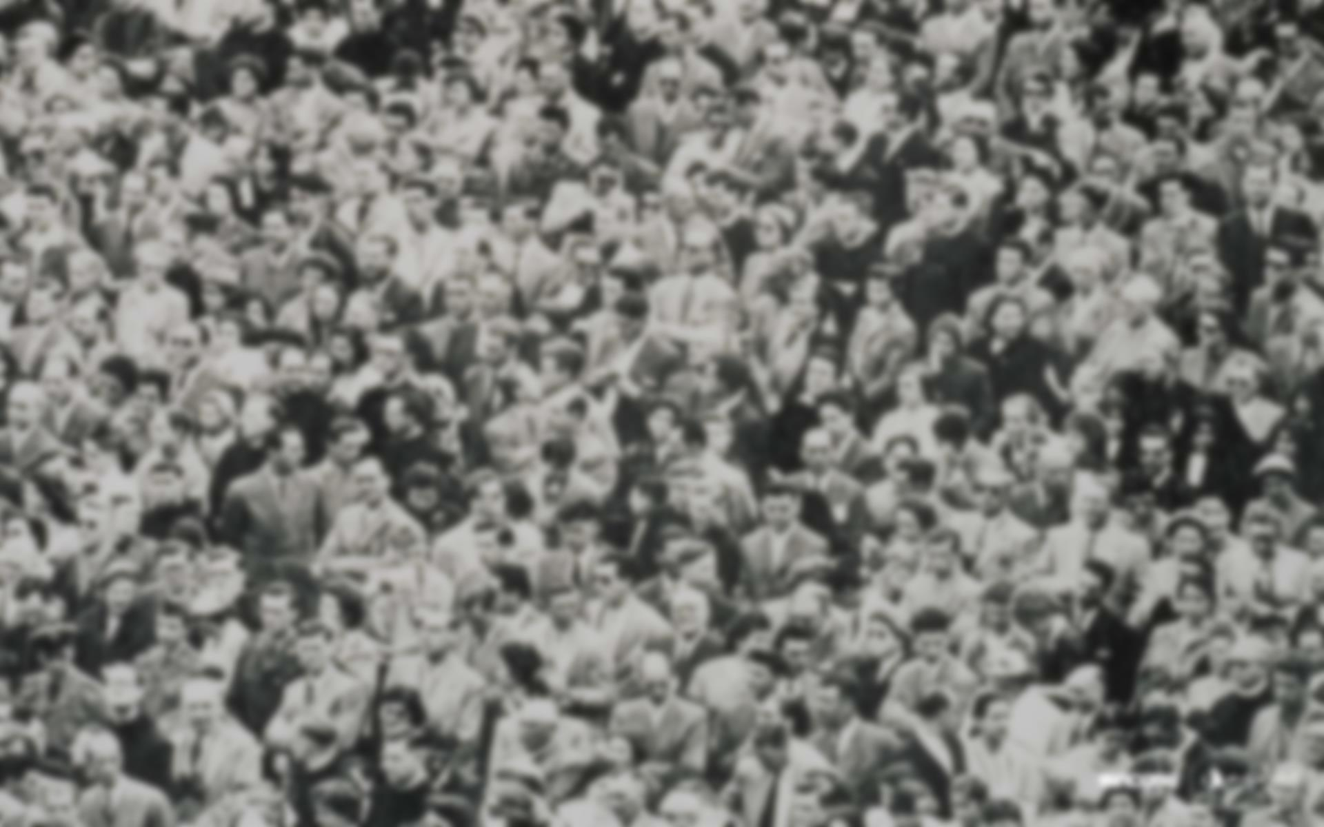
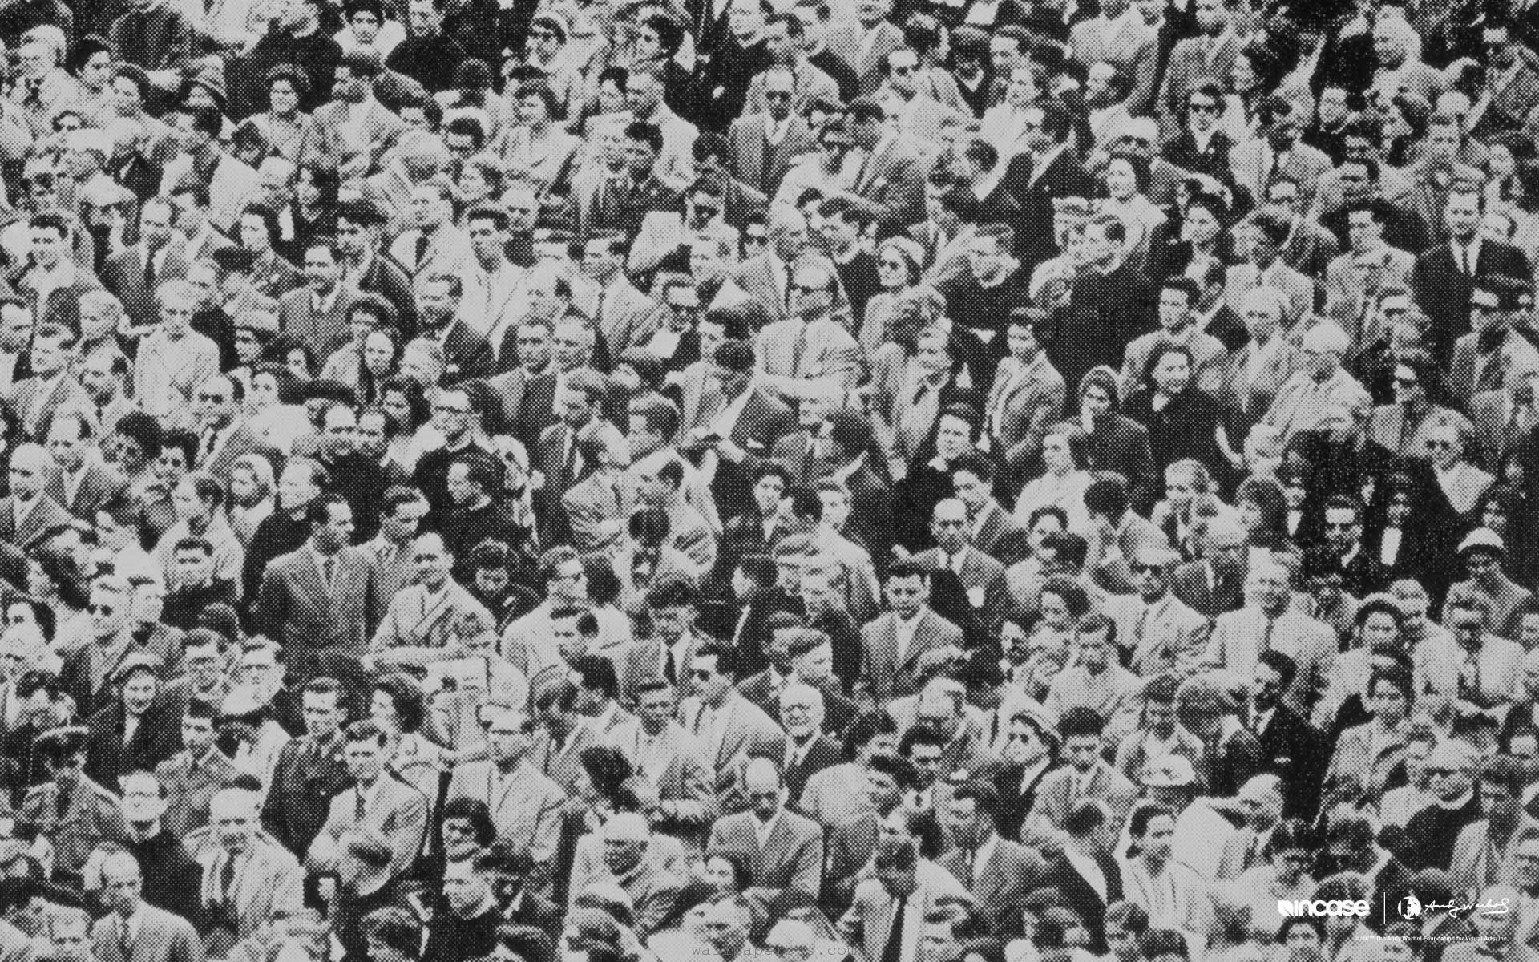
3
PERSONALIZATION

Slide 26

it’s not enough to make technology convenient; consumers want personalized retail experiences

Slide 27

SO where will recommendations come from?

Slide 28

Social media
purchase history
Peer recommendations

Slide 29

SO where will recommendations
come from?
1. SOCIAL MEDIA
2. PURCHASE HISTORY
3. PEER RECOMMENDATIONS

Slide 30

SOCIAL MEDIA and its link to retail
67%
64.8%
Of shoppers purchased a gift they found on social media
OF SHOPPERS USE SOCIAL MEDIA TO FIND THE PERFECT GIFT

Slide 31

IMPORTANCE OF PERSONALIZATION
60% of retail executives say they’re missing personalization out of all shopping factors
90% of customers want better personalization

Slide 32
60% of retail executives say they’re missing personalization out of all shopping factors
90% of customers want better personalization

Slide 33

peer recommendations carry
10x
more weight than recommendations from salespeople

Slide 34

RETAIL
Retail associates will have access to customer’s stored preferences and data –
building customer profile

Slide 35
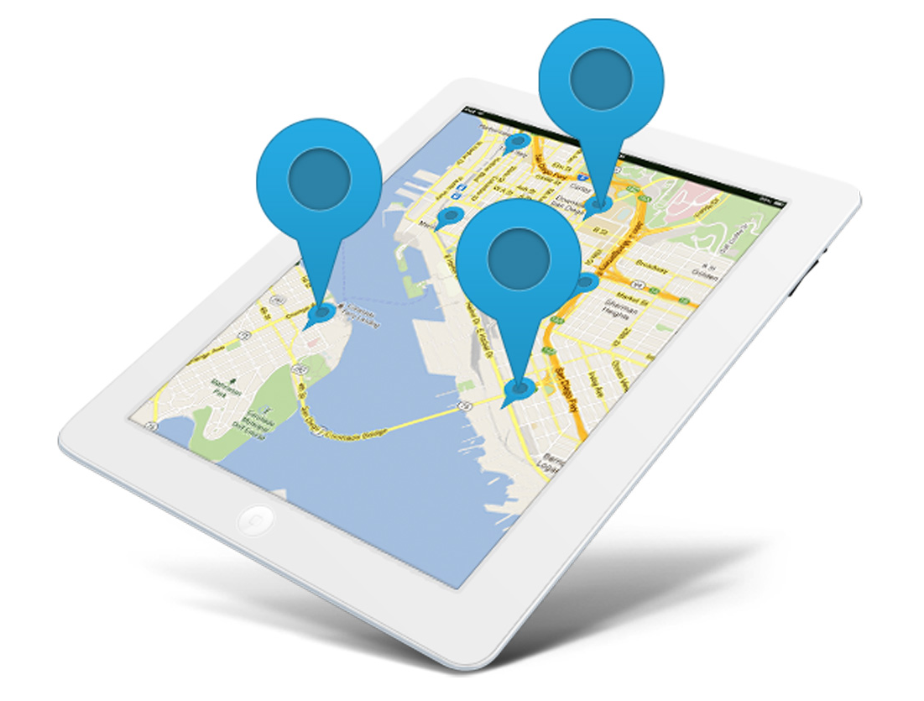
GEOTARGETING
PROMOTIONS/
ADS/
RECOMMENDATIONS
BASED ON LOCATION

Slide 36
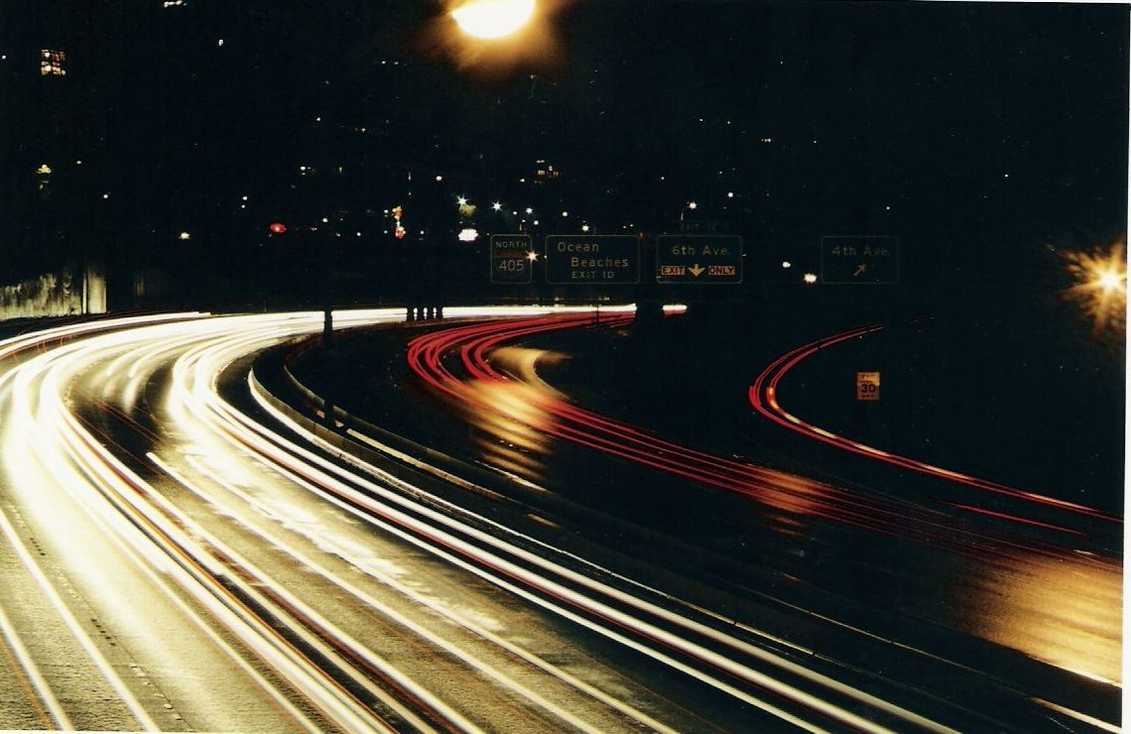


FUTURE OF THE TREND
Personal shopper-style chatbots
Shopping PiNTEREST-style

Slide 37

SO How does this apply to collective?

Slide 38
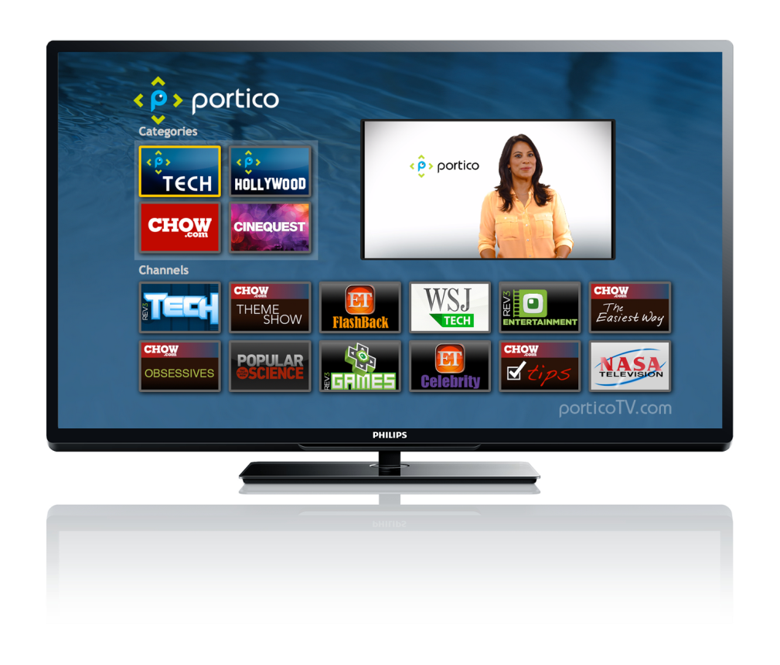
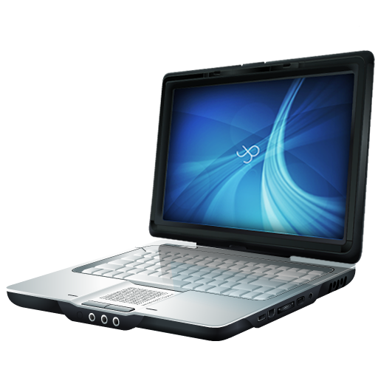
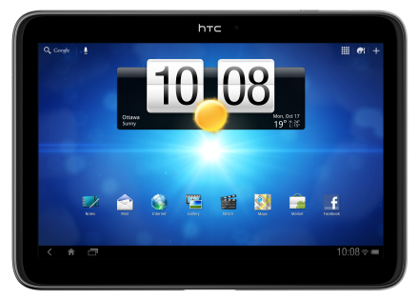
We see collective’s core competency as the ability to reach audiences across multiple screens
Notes:
-reaching the audience , tv platform to digital
-shifting the focus from these different devices to DATA – create audience blocks through clickthrough data
-collecting data from cookies: need to focus on extracting data from social networks and not just browsing
-number of clickthroughs is falling -> need a more reliable way of targeting audiences → extracting data from social networks (this person will recommend to another) is more valuable from → data will be more complete and robust
-

Slide 39
AND THEREFORE,
WE NEED TO FOLLOW WHERE THE AUDIENCE IS GOING
Notes:
-reaching the audience , tv platform to digital
-shifting the focus from these different devices to DATA – create audience blocks through clickthrough data
-collecting data from cookies: need to focus on extracting data from social networks and not just browsing
-number of clickthroughs is falling -> need a more reliable way of targeting audiences → extracting data from social networks (this person will recommend to another) is more valuable from → data will be more complete and robust
-

Slide 40

Because the audience is simplifying devices and interacting more in social networks, we should shift our focus and focus more on extracting valuable data
from social networks

Slide 41
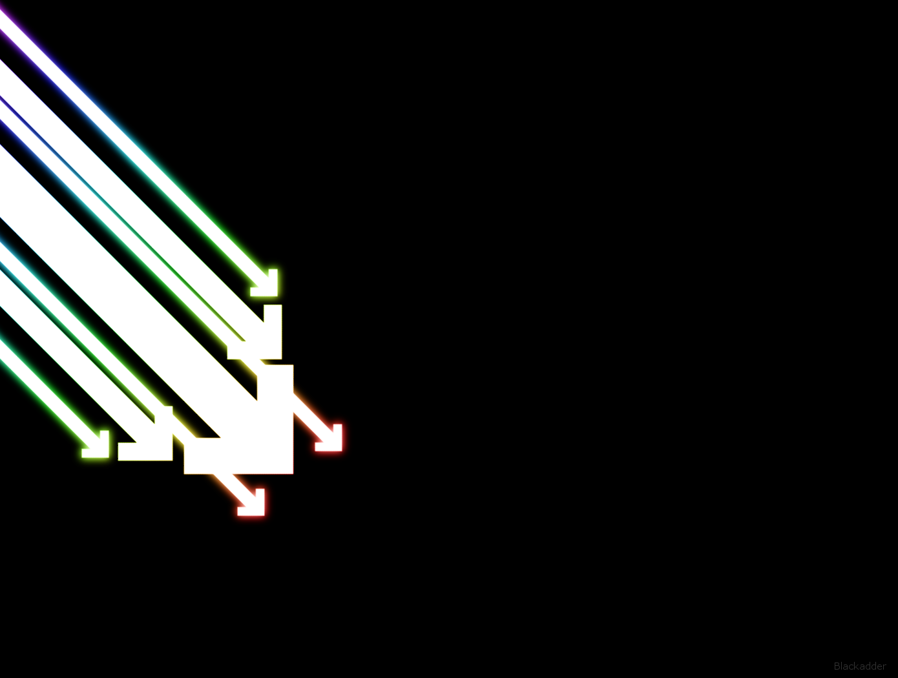
Because the audience is simplifying devices and interacting more in social networks,
we should shift our focus
and focus more on
extracting valuable data
from social networks

